Slide 1
MICROBES in THE AQUATIC ENVIRONMENT
Miguel Uyaguari
Assistant Professor
Department of Microbiology

Slide 2


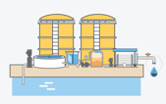

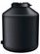


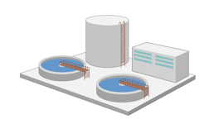



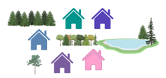
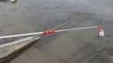
Experimental goals:
Microbial Communities
Antibiotic Resistance Genes
Heavy metal Resistance Genes
Antibiotics, Heavy metals and Pesticides
Community feedback
Design and optimization of engineering design
Water truck
Cistern
Piped
Waste
Source Water
Waste
Leachate
Outcomes:
One Health
Community
Environment
Optimal Engineering Design
Community engagement
Evidence-based policy
Leachate
Spread to new communities
Wastewater treatment
Lagoon
Wastewater

Slide 3
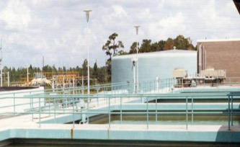
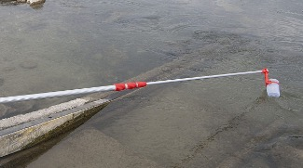
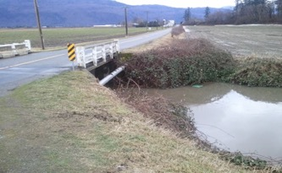
WORKFLOW

Slide 4


Water truck
Cistern
Piped
Waste
Source Water
Bioaerosols
Waste
Leachate
Landfill
Effluents from WWTFs
Spread to new communities
Wastewater treatment
Lagoon
Wastewater

Slide 5
Activity 1. Characterization of Water microbiomes (Years 1 and 2)
Water truck
Four FN communities
(N= 10 samples/year/location)
Cistern
Piped
One urban and two rural communities (N=20/year/location)
Activity 2. Intervention and implementation of better water and wastewater treatment systems (Year 2)
Waste
Bioaerosols
Activity 4. Community dissemination and application plan (Year 4)
Waste
Leachate
Landfill
Effluents from WWTFs
Spread to new communities
Wastewater treatment
Lagoon
Wastewater
Activity 3. Water quality markers and drivers of microbes and ARGs (Year 3)

Slide 6
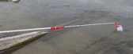
Activity 1
c
d
b
Water truck
Four FN communities
(176 samples/year/location)
Cistern
a
e
Source
Piped
One major urban centre(48 samples/year/location)
Waste
Activity 2
f
m
Waste
Activity 4
Leachate
i
g
Landfill
j
ARGs in the Environment
Spread to new communities
Wastewater treatment
Lagoon
h
Wastewater
k
l
Activity 3

Slide 7

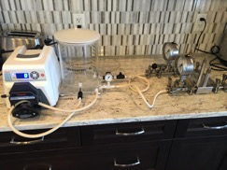
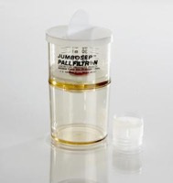
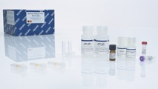
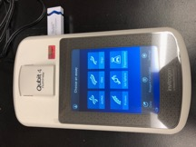
Effluents from WWTPs
TFF system
JumboSep
Extraction of Nucleic Acids
Qiagen kit
Surface water
From 5-10 L to 200 mL
From 200 ml to 300 ul
Viral community structure
Quantitation DNA/RNA
Viral markers [(RT)-PCR]
SEQUENCING

Slide 8
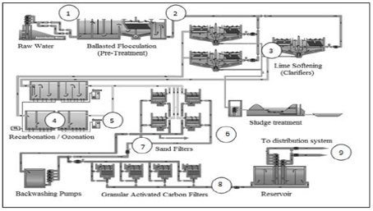

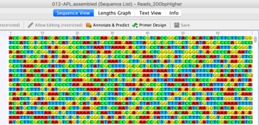
Drinking Water System
DNA extraction
Serial Filtration
Source Water
Qiagen kit
2 L sample
2 L sample per treatment
Bacterial community structure and Monitoring
Data QC
Quantitation DNA
SEQUENCING

Slide 9
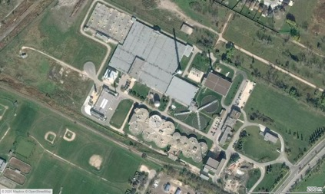
Wastewater Treatment Plant & Bioreactor
Serial Filtration
(fraction enrichment)
Activated Sludge
DNA extraction from bacteria and phages
Effluents
Raw Sewage
Qiagen kit
Sludge Cake
Illumina Technology
Microbiome Structure
Quantitation DNA
Data QC
SEQUENCING

Slide 10
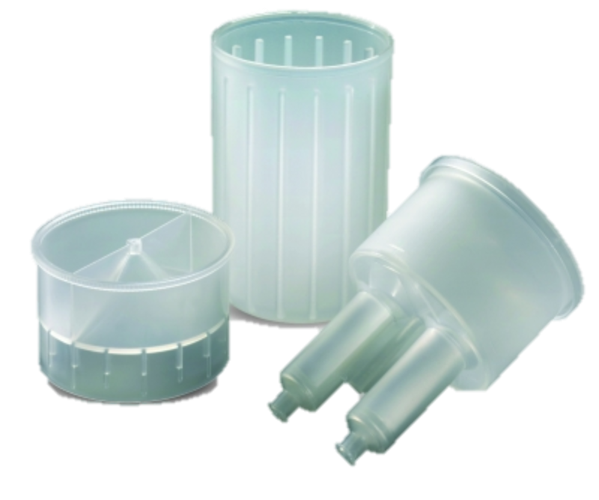
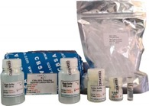
TFF system
Source Water
JumboSep
Qiagen kit
CBSAlife kit
Drinking Water Systems
From 40 L to 500 mL
From 500 ml to 300 ul
(RT)-qPCR
Qubit 4 Fluorometer
Data analysis

Slide 11
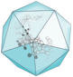
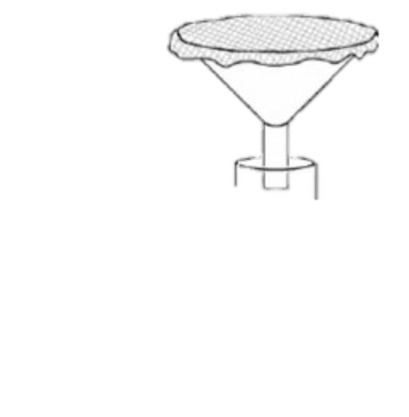
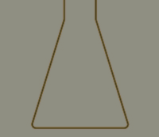
Armored RNA
SARS
Nucleic Acid Extraction
(Commercial extraction kits)
Cheesecloth
Funnel
Drinking Water Systems
www.qiagen.com
2019-nCoV CDC RUO plasmid control
RT-qPCR
Qubit 4 Fluorometer
Data analysis

